Slide 1
Module 9

Slide 2
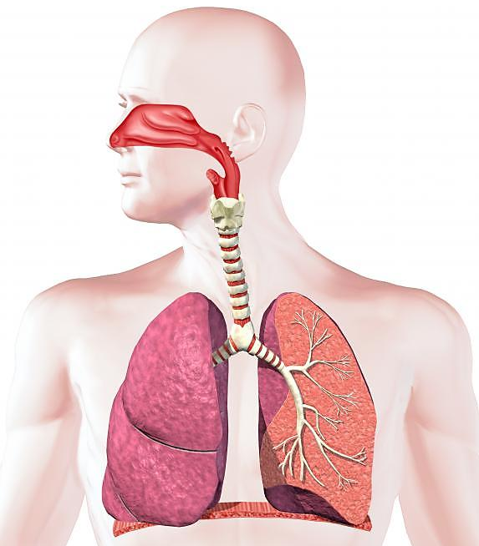


Breathing is a part of respiration. It involves only exchange of gases.
No, this is not respiration. This is called as Breathing.
What is respiration?
Respiration is a process of taking in oxygen and giving out carbon dioxide.
Then what is Respiration ?
O₂
CO₂

Slide 3
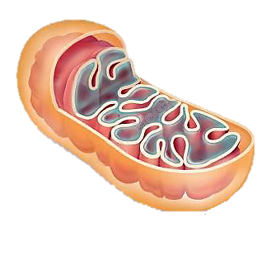

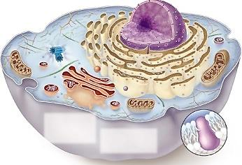

In the mitochondria, food is broken down with the help of oxygen to release energy in the form of ATP.
Inside the cell oxygen enters the mitochondria.
Oxygen enters the lungs through breathing.
Carbon dioxide and water vapour are given out as by products.
Blood carries oxygen to all the cells of the body.
From the lungs oxygen enters the blood.
H₂O
They are given out through breathing.
CO₂
O₂
Glucose
O₂
O₂
O₂
O₂
O₂
O₂
O₂
O₂

Slide 4


Depending upon the presence or absence of oxygen
RESPIRATION
is of two types
In the presence of O₂
In the absence of O₂
Aerobic
respiration
Anaerobic
respiration
Aero : In the presence of air
Anaero : In the absence of air

Slide 5
Phases of Respiration
We saw that breathing is a part of respiration. It involves only exchange of gases.
Actual respiration involves release of energy inside the cell. So we can also called it as
Cellular respiration.
Therefore we can say that

Slide 6
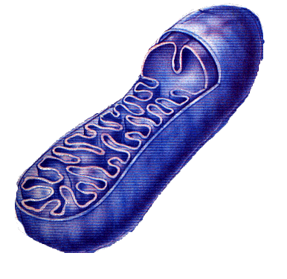
RESPIRATION
Has two phases
Phases
Breathing
Cellular Respiration
Also called as
Also called as
External Respiration
Internal Respiration
Here there is
Here there is
Exchange of gases in a
particular pathway
Release of energy in
the form of ATP
It takes place in
It takes place in
RESPIRATORY SYSTEM
MITOCHONDRIA

Slide 7
Thank You

